Slide 1
Pharmacology (Drugs)

Slide 2
National EMS Education Standard Competencies
Pharmacology
Applies fundamental knowledge of the medications that the EMT may assist/administer to a patient during an emergency.
Notes:
National EMS Education Standard Competencies
Pharmacology
Applies fundamental knowledge of the medications that the EMT may assist/administer to a patient during an emergency.

Slide 3
National EMS Education Standard Competencies
Principles of Pharmacology
Medication safety
Kinds of medications used during an emergency
Notes:
National EMS Education Standard Competencies
Principles of Pharmacology
• Medication safety
• Kinds of medications used during an emergency

Slide 4
National EMS Education Standard Competencies
Medication Administration
Self-administer medication
Peer-administer medication
Assist/administer medication to a patient
Notes:
National EMS Education Standard Competencies
Medication Administration
• Self-administer medication
• Peer-administer medication
• Assist/administer medications to a patient

Slide 5
National EMS Education Standard Competencies
Emergency Medications
Names
Effects
Actions
Indications
Contraindications
Notes:
National EMS Education Standard Competencies
Emergency Medications
• Names
• Effects
• Actions
• Indications
• Contraindications

Slide 6
National EMS Education Standard Competencies
Emergency Medications (cont’d)
Complications
Routes of administration
Side effects
Interactions
Dosages for the medications administered
Notes:
National EMS Education Standard Competencies
• Complications
• Routes of administration
• Side effects
• Interactions
• Dosages for the medications administered

Slide 7
Introduction
Medications are an important intervention.
Medications may alleviate pain and improve the patient’s condition.
Failure to administer medications safely and competently can lead to serious consequences for the patient, including death.
Notes:
Lecture Outline
I. Introduction
A. Medications are an important intervention available to you as an EMT.
B. Used appropriately, medications may alleviate pain and improve a patient’s condition.
C. Failure to administer medications safely and competently can lead to serious consequences for the patient, including death.

Slide 8
Definitions
Pharmacology: the science of drugs
Their ingredients, preparation, uses, actions
Indications: reasons or conditions for which a medication is given
Contraindications: reasons a medication would/should not be given to the patient
Absolute contraindications: reasons a medication should never be given
Relative contraindications: benefits of administering the drug may outweigh the risks

Slide 9
Definitions
Medication: a substance used to treat or prevent disease or relieve pain
Dose: amount of the medication to be given
Based on
Patient’s weight
Patient’s age
Desired action of the medication
Agonist: causes stimulation of receptors
Antagonist: binds to a receptor and blocks other medications or chemicals

Slide 10
Definitions
Action: the therapeutic effect that a medication is expected to have on the body
Adverse effects: any actions of a medication other than the desired one
Unintended effects
Untoward effects
Aka "Side Effects"
May be significant to patient health

Slide 11
Definitions
Pharmacokinetics: actions of the body upon the medication or chemical
Onset of action
Duration
Elimination
Peak
Pharmacodynamics: is the study of the effects of drugs in the body and the mechanism of their action.
Ex: As a drug travels through the bloodstream, it exhibits a unique affinity for a drug-receptor site, meaning how strongly it binds to the site.

Slide 12
Definitions
Prescription drugs:
Distributed only by pharmacists and require a physician’s order
Over-the-counter (OTC) drugs:
May be purchased directly without a prescription
Recreational drugs (heroin, cocaine,…)
Enhancement drugs
Herbal remedies/supplements
Vitamins
Alternative medicines

Slide 13
Herbal remedies/supplements/Medicine
Products made from plants, that are used to treat diseases or to maintain health.
A product made from plants and used solely for internal use is called an herbal supplement.
Herbals come in all forms: dried, chopped, powdered, capsule, liquid; Can be used in various ways
Many prescription and OTC medicines are made from plants but contain only purified ingredients and are regulated by the FDA.

Slide 14
Homeopathy/Homeopathic Medicine
Medical system that was developed more than 200 years ago.
Based on two unconventional theories:
“Like cures like”: the idea disease can be cured by a substance that produces similar symptoms in healthy people.
“Law of minimum dose”: the idea that the lower the dose of the medication, the greater its effectiveness.
Many homeopathic products are so diluted that no molecules of the original substance remain.

Slide 15
Medication/Drug Names
Generic name:
A simple, clear, nonproprietary name
The medicine's active ingredient that makes it work
Ex: ibuprofen (brand names: Advil, Motrin)
Trade name: manufacturer’s brand name
One drug may have more than one trade name.
Ex: acetyl salicylic acid is Aspirin,
Chemical name
The composition and structure of the medicinal substance
Ex ethyl-1-methyl-4-phenyl isonipecotate hydrochloride
Notes:
Lecture Outline
B. Medication names
1. The generic name is a simple, clear, nonproprietary name.
a. Generic names are not capitalized.
2. The trade name is the brand name that a manufacturer gives to a drug.
a. Trade names begin with a capital letter.
b. One drug may have more than one trade name.

Slide 16
Medication Forms
The form of medication usually dictates the route of administration.
The manufacturer chooses the form to ensure:
Proper route of administration
Timing of the medication’s release into the bloodstream
Effects on the target organs or body systems
(Cont)
Notes:
Lecture Outline
III. Medication Forms
A. The form of a medication usually dictates the route of administration.
1. The manufacturer chooses the form to ensure:
a. Proper route of administration
b. Timing of the medication’s release into the bloodstream
c. Effects on the target organs or body systems

Slide 17
Medication Forms Summary
Liquids
(Solvent = liquid; Solute = that which is dissolved)
Fluid extracts.
Tinctures - extracted chemically with alcohol
Spirits - contain volatile chemicals dissolved in alcohol
Syrups - dissolved in sugar and water
Elixirs - drugs in an alcohol solvent
Milks - colloidal dispersions of insoluble drugs in a liquid medium
Emulsions - oily substance is mixed with a solvent
Liniments - medicated topical preparation for application to the skin
(Cont)

Slide 18
Medication Forms Summary
Solid drugs
Extracts - concentrates
Powders - self explanatory
Pills - easy to swallow shape and form
Capsules - gelatin containers with powder
Tablets - compressed powder in pill form
Not solids or liquids.
Ampule (or ampoule).
Vial
Suppositories.
Ointments.
Troches or lozenges.
(Cont)

Slide 19
Medication Forms Summary
Lotions
Usually aqueous preparations that contain suspended matter.
Applications (usually applied to the skin by patting).
Uses
Cleansing
Astringent (drawing action).
Need to shake well before using, e.g. calamine.
Solutions - drugs dissolved in water
D5W (dextrose 5% in water) can be used as a diluent to prepare other injectable medications for IV administration.
(Cont)

Slide 20
Medication Forms Tablets and Capsules
Capsules are gelatin shells filled with powdered or liquid medication.
Tablets often contain other materials that are mixed with the medication and compressed.
Notes:
Lecture Outline
B. Tablets and capsules
1. Most medications given by mouth are in tablet or capsule form.
2. Capsules are gelatin shells filled with powder or liquid medication.
3. Tablets often contain other materials that are mixed with the medication and compressed.

Slide 21
Medication Forms Solutions and Suspensions
A solution is a liquid mixture of substances.
Will not separate by filtering or letting it stand
Can be given as an IV, IM, or SC injection
A suspension is substance that does not dissolve well in liquids.
Will separate if it stands or is filtered.
Notes:
Lecture Outline
C. Solutions and suspensions
1. A solution is a liquid mixture of one or more substances that cannot be separated simply.
2. Solutions can be given by almost any route.
a. When given by mouth, solutions may be absorbed from the stomach fairly quickly because the medication is already dissolved
b. Many solutions can be given as an IV, IM, or SC injection.
3. A suspension is a mixture of finely ground particles that are distributed evenly throughout a liquid by shaking or stirring but do not dissolve.
a. Suspensions separate if they stand or are filtered.
b. It is important to shake or swirl a suspension before its administration

Slide 22
Medication Forms Topical Medications
Include lotions, creams, and ointments
Applied to skin surface and affect only that area
Examples
Lotion: calamine lotion
Cream: hydrocortisone cream
Ointment: Neosporin ointment
Notes:
Lecture Outline
E. Topical medications
1. Include lotions, creams, and ointments
2. Applied to the skin surface and affect only that area

Slide 23
Medication Forms Transcutaneous Medications
Designed to be absorbed through the skin
Also referred to as transdermal
May have systemic effects
If you touch the medication with your skin, you will absorb it just like the patient.
Notes:
Lecture Outline
F. Transcutaneous medications
1. Also referred to as transdermal medications
2. Absorbed through the skin
3. Many transdermal medications have systemic (whole-body) effects
4. If you touch the medication with your skin, you will absorb it just like the patient.

Slide 24
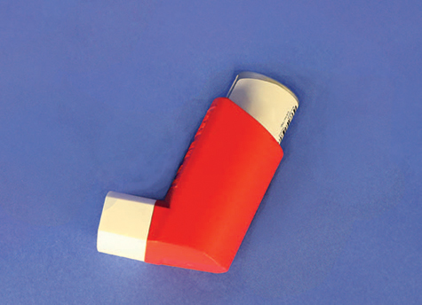
Medication Forms Metered-Dose Inhalers
© Jones & Bartlett Learning.
Liquids or solids if broken into small enough droplets or particles may be inhaled.
A metered-dose inhaler (MDI) directs such substances through the mouth into lungs.
Metered-Dose: Delivers the same amount (dose) each time
FIGURE 12-2 Some medications are inhaled into the lungs with a metered-dose inhaler so that they can be absorbed into the bloodstream near the site of desired action more quickly.
Notes:
Lecture Outline
D. Metered-dose inhalers
1. Liquids or solids that are broken into small enough droplets or particles may be inhaled.
2. Spray canister directs such substances through the mouth and into the lungs.
3. Delivers the same amount of medication each time it is used
4. Often used for respiratory illnesses such as asthma or emphysema

Slide 25
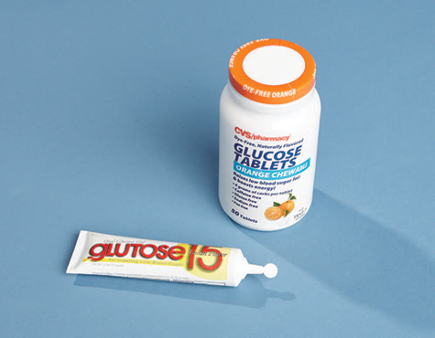
Medication Forms Gels
Semiliquid
Administered in capsules or through plastic tubes
Example: oral glucose for patient with diabetes
© Jones & Bartlett Learning.
FIGURE 12-4 Oral glucose, used in diabetic emergencies, is available in gel and tablet forms.
Notes:
Lecture Outline
G. Gels
1. Semiliquid
2. Administered in capsules or through plastic tubes

Slide 26
Medication Forms Gases for Inhalation
Usually delivered through a (non-rebreathing) mask or nasal cannula
Outside the operating room, most commonly used is oxygen
Notes:
Lecture Outline
H. Gases for inhalation
1. Usually delivered through a nonrebreathing mask or nasal cannula
2. Oxygen is the medication most commonly used in gas form outside the operating room.

Slide 27
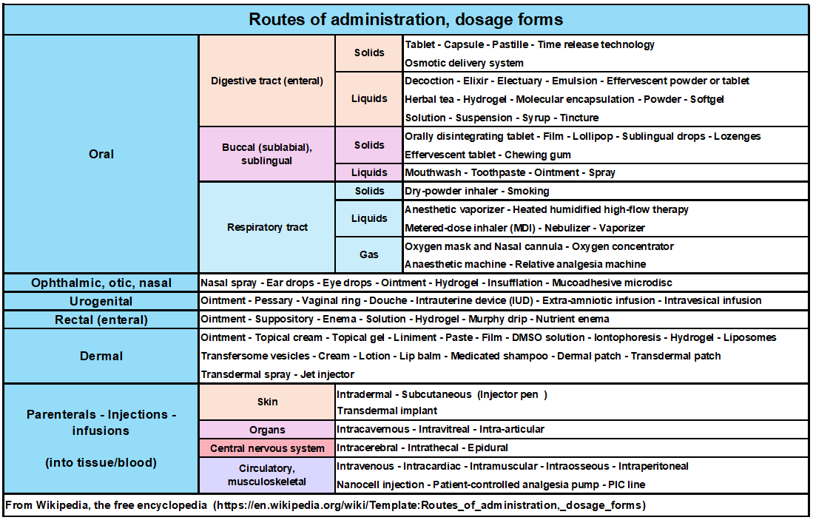

Slide 28
Medication Action
How a drug or other substance produces an effect in the body.
Drug's mechanism of action
How it affects a specific target in a cell (such as an enzyme), or a cell function (such as cell growth).
Factors that influence action of drugs
Dosage:
Minimal, Maximal, Toxic, Lethal.
Route of administration.
Shock states.
Age of the patient.
Condition of the patient.

Slide 29
Drug Sources (for what WE do)
The Patient
Prescribed for and provided by the patient
We can assist/administer based on our "Protocols"
Carried on our Ambulance
Any drugs carried on the Ambulance must be authorized by the Medical Director
Typical "drugs"
Epinephrin auto injector
Aspirin
Oxygen
Naloxone
Activated charcoal
Glucose

Slide 30
Medication Administration and the EMT
Circumstances in which medications may be administered:
Peer-assisted administration
You administer to yourself or your partner.
Patient-assisted administration
You assist the patient with administering their med.
EMT-administered medications
You directly administer the medication to the patient.
Determined by:
State and local protocols
Medical control
Notes:
Lecture Outline
A. Over the years, EMTs have been allowed increasing responsibility to work with medications.
B. Many departments have strict guidelines on when an EMT is allowed to administer a medication.
1. Peer-assisted medication
a. You administer medication to yourself or your partner.
b. Example: You were exposed to a toxic agent.
2. Patient-assisted medication
a. You assist the patient with administering his or her own medication.
b. Examples: epinephrine auto-injector, nitroglycerin, metered-dose inhaler
3. EMT-administered medication
a. The EMT directly administers the medication to the patient.
b. The patient may be severely confused or unable to understand the need for the medication.
c. Examples: oxygen, oral glucose, aspirin
C. Medical control, state guidelines, and local protocols determine what an EMT in your system may administer.
1. Refer to your local standards to obtain a listing of how and when EMTs can administer medications.

Slide 31
General Steps in Administering Medication
Medications should be administered only under the authorization of medical control.
Follow the “rights” of medication administration.
Medication errors almost always result from failure to follow these “rights.”
Notes:
Lecture Outline
IV. General Steps in Administering Medication
A. Medications should be administered only under the authorization of online or off-line medical direction.
Follow the “rights.”
1. Right patient: Ensure that the patient who needs the medication is the person who receives the medication.
2. Right medication and indication: Verify the proper medication and prescription.
3. Right dose: Verify the form and dose of the medication.
4. Right route: Verify the route of the medication.
5. Right time: Check the expiration date and condition of the medication.
6. Right education: Inform the patient of the medication you intend to administer, including any likely adverse effects or unusual sensations he or she may experience.
7. Right to refuse: Patients with decision-making capacity can decline or refuse proposed interventions or medications.
8. Right response and evaluation: Monitor the patient’s vital signs, mental status, signs of perfusion, and respiratory effort after medication administration. Assess for the anticipated response, and observe for any adverse medication effects.
9. Right documentation: Document your actions and the patient’s response.
C. Medication Administration Cross-Check and Procedure
1. Using a verbal cross-check procedure that verifies you are giving the right drug to the right patient at the right dose has been found to reduce medication errors.

Slide 32
Six Critical Rights (Table 12-3)
1) | Right Patient: The person who needs it is who receives it
2) | Right Medication: Correct medication for condition
3) | Right Form/Dose: Verify the form and dose
4) | Right Route: Verify the route of administration
5) | Right Exp. Date/Condition: Check the expiration date
6) | Right Documentation: Document actions and response
Notes:
Lecture Outline
1. Right patient: Ensure that the patient who needs the medication is the person who receives the medication.
2. Right medication and indication: Verify the proper medication and prescription.
3. Right dose: Verify the form and dose of the medication.
4. Right route: Verify the route of the medication.
5. Right time: Check the expiration date and condition of the medication.
6. Right education: Inform the patient of the medication you intend to administer, including any likely adverse effects or unusual sensations he or she may experience.
7. Right to refuse: Patients with decision-making capacity can decline or refuse proposed interventions or medications.
8. Right response and evaluation: Monitor the patient’s vital signs, mental status, signs of perfusion, and respiratory effort after medication administration. Assess for the anticipated response, and observe for any adverse medication effects.
9. Right documentation: Document your actions and the patient’s response.

Slide 33
The Rest of the Rights
7) | Right education: Inform the patient about the medication
8) | Right to refuse: Patients can decline or refuse
9) | Right response and evaluation: Assess for the anticipated response
Notes:
Lecture Outline
1. Right patient: Ensure that the patient who needs the medication is the person who receives the medication.
2. Right medication and indication: Verify the proper medication and prescription.
3. Right dose: Verify the form and dose of the medication.
4. Right route: Verify the route of the medication.
5. Right time: Check the expiration date and condition of the medication.
6. Right education: Inform the patient of the medication you intend to administer, including any likely adverse effects or unusual sensations he or she may experience.
7. Right to refuse: Patients with decision-making capacity can decline or refuse proposed interventions or medications.
8. Right response and evaluation: Monitor the patient’s vital signs, mental status, signs of perfusion, and respiratory effort after medication administration. Assess for the anticipated response, and observe for any adverse medication effects.
9. Right documentation: Document your actions and the patient’s response.

Slide 34
When EMTs administer a drug…
We NEED to know:
Effects of drug.
Proper dosage.
Contraindications.
Side effects.
Administration techniques (mode and rate).
We Need to observe changes in the Patient
Local effects as well as General or Systemic effects.
Pain level
Speech
Responsiveness
Breathing Changes

Slide 35
Routes of Administration
How the medication enters the body
Affect how a medication works
Absorption is the process by which medications travel through body tissues to the bloodstream.
Notes:
Lecture Outline
3. Absorption: the process by which medications travel through body tissues to the bloodstream
4. Common routes of administration
a. Per rectum (PR)
i. “By rectum”
ii. Easy to administer; provides reliable absorption
b. Oral (PO)
i. “By mouth”
ii. Takes as long as 1 hour for absorption to occur

Slide 36
Common routes of administration
Oral (PO): by mouth
Latin phrase “per os,” which translates to “by mouth".
Can take as long as 1 hour for absorption to occur
Per rectum (PR): by rectum
Easy to administer; provides reliable absorption
Inhalation: inhaled into the lungs
Absorbed into the bloodstream quickly
Aerosols, fine powders, and sprays
Sublingual (SL): under the tongue
Through the oral mucosa; absorbed within minutes
(Cont)
Notes:
Lecture Outline
3. 4. Common routes of administration
a. Per rectum (PR)
i. “By rectum”
ii. Easy to administer; provides reliable absorption
b. Oral (PO)
i. “By mouth”
ii. Takes as long as 1 hour for absorption to occur

Slide 37
Common routes of administration
Transcutaneous (transdermal): through the skin
Applied as a patch; Longer-lasting than other routes
Intranasal (IN): into the nostril via a mucosal atomizer device (MAD)
Quick absorption
Intravenous (IV): into the vein
Intraosseous (IO): into the bone
Subcutaneous (SC): beneath the skin
Intramuscular (IM): into the muscle
(Cont)
Notes:
Lecture Outline
Inhalation
i. Breathed into the lungs
ii. Absorbed into the bloodstream quickly
iii. Forms include aerosols, fine powders, and sprays
h. Sublingual (SL)
i. “Under the tongue”
ii. Enters through the oral mucosa under the tongue and is absorbed into the bloodstream within minutes
i. Transcutaneous (transdermal)
i. “Through the skin”
ii. Applied as a patch to the skin
iii. Longer-lasting effect than other routes
j. Intranasal (IN)
i. Relatively new format for the delivery of medication
ii. Medication is pushed through a mucosal atomizer device (MAD) that aerosolizes the liquid for delivery into the nostril.
iii. Quick absorption

Slide 38
Common routes of administration
Enteral medications enter the body through the digestive system.
Often in pill or liquid form such as cough medicine
Medications administered via this route tend to be absorbed slowly and are not commonly used in an emergency setting
Parenteral medications enter the body by routes other than the digestive tract. Usually used for drugs given by injection or infusion.
Often in liquid form through needles or syringes
Absorbed more quickly; offer a more predictable and measurable response.
Notes:
Lecture Outline
C. Routes of administration
1. Enteral medications enter the body through the digestive system.
a. Often in pill or liquid form such as cough medicine
b. Medications administered via this route tend to be absorbed slowly and are not commonly used in an emergency setting.
2. Parenteral medications enter the body by some other means.
a. Often in liquid form administered through needles or syringes
b. Absorbed more quickly and offer a more predictable and measurable response

Slide 39
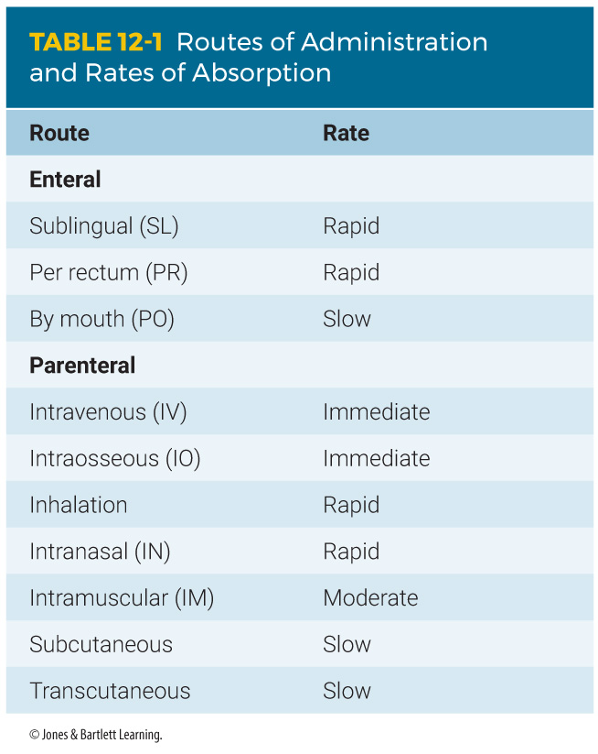
Routes and Absorption rates
Notes:
Table 12-1 lists common routes of medication administration and rates of absorption.

Slide 40
Remember??
S: | Signs/Symptoms
A: | Allergies
M: | Medications
P: | Past Pertinent Hx
L: | Last Oral Intake
E: | Events leading Up
O: | Onset
P: | Provokes
Q: | Quality
R: | Radiation/Region
S: | Severity
T: | Time

Slide 41
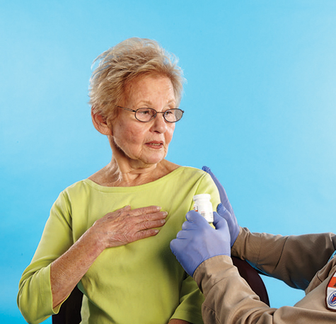
Oral Medications
Confirm that the patient has a patent airway and is able to swallow.
Instruct the patient to swallow or chew the medication.
© Jones & Bartlett Learning.
FIGURE 12-6 Instruct the patient to chew (eg, baby aspirin) or swallow the medication.
Notes:
Lecture Outline
A. Oral medications
1. Follow the following steps to perform oral medications:
a. Take standard precautions
b. Confirm the medication is not expired
c. Obtain medical direction per local protocol.
d. Confirm that the patient has a patent airway and is able to swallow or chew the medication.
e. Monitor the patient’s condition and document.

Slide 42
Oral Medications
Oral glucose
A sugar that cells use for energy: Treats hypoglycemia
EMTs give it only by mouth.
Do not give to an unconscious patient or one who cannot protect the airway.
Aspirin (Given ONLY under protocol direction)
Reduces fever, pain, and inflammation
Inhibits platelet aggregation
Useful during heart attack
Contraindications
Hypersensitivity to aspirin
Liver damage, bleeding disorder, asthma
Should not be given to children
Notes:
Lecture Outline
2. Oral glucose
a. Glucose is a sugar that cells use for energy; it is necessary for brain cells’ survival.
b. Hypoglycemia: extremely low blood glucose
c. Oral glucose can counteract the effects of hypoglycemia.
d. An EMT can give glucose only by mouth in the form of a gel
e. Never administer oral medications to an unconscious patient or to one who is unable to swallow or protect the airway.

Slide 43
Sublingual Medications
Advantages
Easy to advise patients
Quick absorption
Disadvantages
Constant evaluation of the airway
Possible choking
Not for uncooperative or unconscious patients
Notes:
Lecture Outline
B. Sublingual medications
1. Considerations
a. Advantages
i. Easy to talk with awake and alert patients and advise them to place a pill under their tongue
ii. Absorption rates are relatively quick.
b. Disadvantages
i. Any medication placed in the mouth requires constant evaluation of the airway.
ii. Should not be used if the patient is uncooperative or unconscious

Slide 44
Sublingual Medications Nitroglycerin
Relieves angina pain (cardiac patients)
Increases blood flow
Relaxes veins (reduces blood pressure)
Before administering:
Check blood pressure.
Obtain order to administer (Follow protocol)
If no relief: Possibility of MI,
Should not be used with erectile dysfunction medications
May cause mild headache
Notes:
Lecture Outline
2. Nitroglycerin
a. Many cardiac patients carry fast-acting nitroglycerin to relieve angina pain.
b. Increases blood flow by relieving the spasms and causes arteries to dilate by relaxing muscles of coronary arteries and veins.
c. Also relaxes veins throughout the body so that less blood is returned to the heart, decreasing workload and blood pressure.

Slide 45
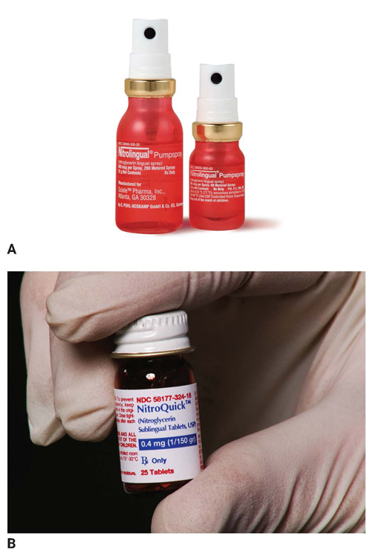
Sublingual Medications Nitroglycerin
Administration - tablet
Sublingually under the tongue
Slight tingling or burning
Storage is important: Temperature/Light
Administration - metered-dose spray
On or under tongue
One spray = one tablet
Administration considerations
Wait 5 minutes before repeating dose.
Monitor vital signs.
Wear gloves.
Know local protocols.
FIGURE 12-7 Nitroglycerin, which is prescribed for chest pain, can be given sublingually as a spray or tablet.
A: Courtesy of Shionogi Pharma, Inc.; B: © Jones & Bartlett Learning.
Notes:
Lecture Outline
f. Administration by tablet
i. Place the tablet under the tongue, where it dissolves.
ii. The patient should experience a slight tingling or burning sensation.
iii. Nitroglycerin should be stored in its original glass container with the cap screwed on tightly.
g. Administration by metered-dose spray
i. Deposits medication on or under the tongue
ii. One spray equals one tablet.

Slide 46
Intramuscular Medications
Advantages
Quick, easy access without using vein
Stable blood flow to muscles
Disadvantages
Use of a needle (and subsequent pain)
Patients may fear pain or injury.
Notes:
Lecture Outline
C. Intramuscular medications
1. Considerations
a. Advantages
i. Provides quick and easy access to the circulatory system without the need for placing a needle within a vein
ii. Blood flow to the muscles is relatively stable even during circumstances of severe illness or injury.
b. Disadvantages
i. Use of a needle (and subsequent pain)

Slide 47
Intramuscular Medications: Epinephrine (aka: adrenaline)
Controls fight-or-flight response
Primary medication for delivery IM
Sympathomimetic
Mimics the effects of sympathetic nervous system
May lead to overstimulation of the fight-or-flight response
Delivered with an auto-injector to treat life-threatening anaphylaxis
Do not give to patients with hypertension, hypothermia, MI, or wheezing.
Relative contraindication
Notes:
Lecture Outline
Epinephrine (adrenaline)
Also known as adrenaline
Released inside the body when there is sudden stress
Main hormone that controls the body’s fight-or-flight response
Increases heart & breathing rate, blood pressure, pupil size;
Constricts blood vessels and reduces digestive juices
Improves eyesight and slows down digestion

Slide 48
Intramuscular Medications Naloxone
Used to reverse the effects of an opioid overdose
Most commonly available as Nasal Spray
Important considerations:
Follow State protocol.
Effects may not last as long as opioids; repeated doses may be necessary
Biphasic: Recurrence of symptoms after an interval of time.
Can cause severe withdrawal symptoms
including seizures and cardiac arrest
Consider your safety.
Notes:
Lecture Outline
3. Naloxone
a. Used to reverse the effects of an opioid overdose
b. Can be administered by family members or caregivers
c. Considerations:
i. Follow local protocol.
ii. Find out if naloxone has been administered by a bystander prior to your arrival.
iii. The effect of naloxone may not last as long as those of opioids. Repeat doses may be needed.
iv. Administration of naloxone to opioid-dependent patients can cause severe withdrawal symptoms, including seizures and cardiac arrest.
v. Consider personal safety.

Slide 49
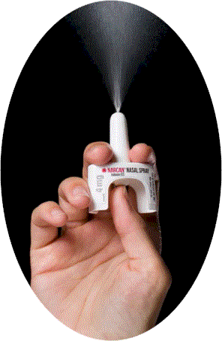
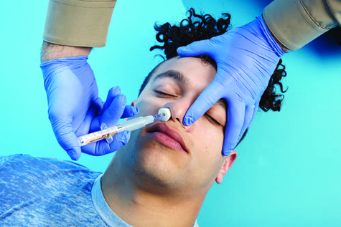
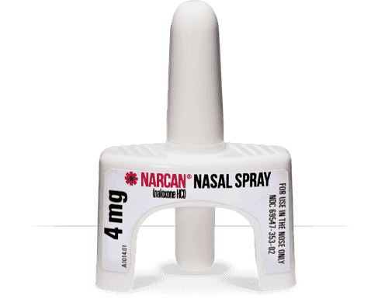
Intranasal Medications Naloxone
The most common technique for naloxone administration is via the intranasal route.
© Jones & Bartlett Learning.
FIGURE 12-9 Some EMTs may administer naloxone
intranasally to treat an opioid overdose.
Notes:
Lecture Outline
D. Intranasal medications
1. Naloxone
a. The most common technique for naloxone administration is via the intranasal route.
b. The same considerations described for administering injectable naloxone apply here.
c. If naloxone is not available, bag-mask ventilations may be required.

Slide 50
Inhalation Medications Oxygen
All cells need it to survive.
Provide Supplemental O₂ via:
Nonrebreathing mask (at 10 to 15 L/min)
Nasal cannula (2 to 6 L/min)
Venturi Mask
Simple Mask
Provide Ventilations with O₂ via:
Bag-mask device at 15 L/min
Always Follow O₂ Safe handling procedures
Notes:
Lecture Outline
E. Inhalation medications
1. Oxygen
a. By far the most commonly administered medication in the prehospital setting
b. All cells, especially those in the heart and brain, need oxygen to function properly.
c. Generally administered:
i. Via a nonrebreathing mask at 10 to 15 L/min
ii. Via nasal cannula at 2 to 6 L/min
d. Must also provide artificial ventilations if the patient is not breathing (using a bag-mask device at 15 L/min)
e. Ensure that there are no open flames, lit cigarettes, or sparks in the area in which you are administering oxygen.

Slide 51
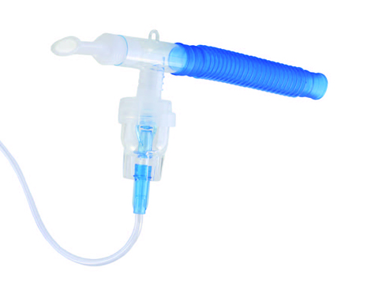
Inhalation Medications MDIs and nebulizers
Liquid turned into mist or spray
Medication is atomized, breathed in, and delivered to alveoli
Fast absorption rate
Easy route to access
Portable
Cannot be used for unconscious patients
© Charles Brutlag/Shutterstock.
FIGURE 12-10 Metered-dose inhalers and small-volume nebulizers (shown here) convert liquid medications into a fine mist.
Notes:
Lecture Outline
2. Metered-dose inhalers and nebulizers
a. Used to administer liquid medications that have been turned into a fine mist by a flow of air or oxygen
b. Medication is atomized, breathed into the lungs, and delivered to the alveoli
c. Advantages
i. Fast and relatively easy route to access.
d. Disadvantages
i. Patient needs to be cooperative and control breathing
ii. Cannot be used for unconscious patients
3. Medications administered using an MDI or small-volume nebulizer (SVN)
a. An MDI requires a great deal of coordination to administer.
i. May be difficult to achieve when a person is having trouble breathing

Slide 52
Inhalation Medications MDI- Metered Dose Inhaler
A metered-dose inhaler contains a canister of medicine.
To use, press down firmly on the top of the medicine canister to release one “puff” of medication as patient inhales slowly
Sprays a pre-set amount of medicine into and through the mouth and is inhaled into the airways.
Notes:
Lecture Outline
b. Use a spacer (adapter) to avoid spray misdirection.
i. A spacer fits over the inhaler like a sleeve.
ii. A spacer has an opening for the inhaler at one end and a mouthpiece on the other end.
iii. The patient sprays the prescribed dose into the chamber and then breathes in and out of the mouthpiece until the mist is completely inhaled.
iv. Spacer devices are especially useful with young children who have difficulty using an MDI.

Slide 53
Inhalation Medications MDI-Spacer
Attaches to MDI; provides an additional reservoir between the mouthpiece patient
Provides better disbursal of the medication into the lungs
Patient sprays the prescribed dose into the chamber and can then take several breaths
Especially useful with young children
Reduces deposit of medication on upper airway surfaces
Notes:
Lecture Outline
b. Use a spacer (adapter) to avoid spray misdirection.
i. A spacer fits over the inhaler like a sleeve.
ii. A spacer has an opening for the inhaler at one end and a mouthpiece on the other end.
iii. The patient sprays the prescribed dose into the chamber and then breathes in and out of the mouthpiece until the mist is completely inhaled.
iv. Spacer devices are especially useful with young children who have difficulty using an MDI.

Slide 54
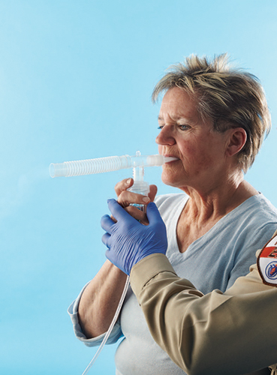
Inhalation Medications Small-volume nebulizers
© Jones & Bartlett Learning.
Easier to use than MDIs
Take longer to deliver medication
Require an external air or oxygen source
More effective in patients with moderate to severe respiratory distress
Can be used while a patient is on CPAP and during bag-mask ventilation
FIGURE 12-12 With a small-volume nebulizer, liquid medication is atomized by the flow of oxygen. The patient then breathes in the medication.
Notes:
Lecture Outline
c. SVNs are much easier to use than MDIs.
i. Take longer to deliver the medication
ii. Require an external air or oxygen source
iii. Can be more effective than an MDI in patients with moderate to severe respiratory distress.
iv. Can be used while a patient is on CPAP and during bag-mask ventilation
v. Can be easily adapted to a nonrebreathing mask

Slide 55
Patient Medications - Assessment
Ask:
What are you prescribed
What do you take
What have you taken
Changes in medications, dosage
May provide clues to the patient’s condition
Guides treatment
Will be useful to the emergency department
Medications are often not taken as prescribed.
Medications may alter the clinical presentation.
Notes:
Lecture Outline
VII. Patient Medications
A. Patient assessment includes finding out which medications the patient is currently taking.
B. This information may provide vital clues to the patient’s condition.
1. May help guide your treatment
2. May be extremely useful to the emergency department physician
3. Can help you determine a chronic or underlying condition when a patient is unable to relate his or her medical history
C. Discover what the patient takes and transport the medications or a list of them with the patient to the emergency department.
D. Ask about use of any nonprescription drugs (eg, OTC, herbal, or illegal drugs).

Slide 56
Medication Errors
The Inappropriate use of a medication
Ensure environment does not contribute to errors.
Ensure lighting is sufficient; Organize equipment; Limit distractions; "Cheat Sheet" reminder
If a medication error occurs:
Provide appropriate patient care.
Notify medical control.
Follow protocols.
Document thoroughly, accurately, and honestly.
Talk with your partner, supervisor, or medical director.
Notes:
Lecture Outline
VIII. Medication Errors
A. A medication error is inappropriate use of a medication that could lead to patient harm.
B. Ensure that the environment does not contribute to errors.
1. Ensure lighting is sufficient.
2. Organize equipment.
3. Limit distractions as much as possible.
4. Consider using a “cheat sheet” to help yourself remember all crucial steps to medication administration.

Slide 57

NJ Protocols (https://www.nj.gov/health/ems/education/)
BLS Protocols
Anaphylaxis Protocol
Epinephrin Autoinjector
Atraumatic Chest Pain/Discomfort Protocol
Nitroglycerine
Aspirin
Opiate Overdose Protocol
Naloxone
Respiratory Distress Protocol
MDI
Large and Smal volume Nebulizer
CPAP
EMS Spinal Motion Restriction Position Statement

Slide 58

The NJ EMS Field Guide is a convenient field reference manual for New Jersey's EMS professionals.

Slide 59
Drug References
Physician's Desk Reference (PDR)
Hospital formulary
Compilation of medications
AMA Drug Evaluations:
Physicians information on comparative drug therapy
Drug Inserts: - packaged with drug
The Merck Manuals
Medical references published by the American pharmaceutical company Merck & Co., that cover a wide range of medical topics, including disorders, tests, diagnoses, and drugs. The manuals have been published since 1899,

Slide 60
JUST an Adder!!!
B.E. F.A.S.T.

Slide 61

New Jersey Stroke Coordinator Consortium
Stroke Awareness Education
For EMS

Slide 62

Don’t Just Act F.A.S.T……. B.E.F.A.S.T.
Remember Time Lost
is Brain Lost!!

Slide 63
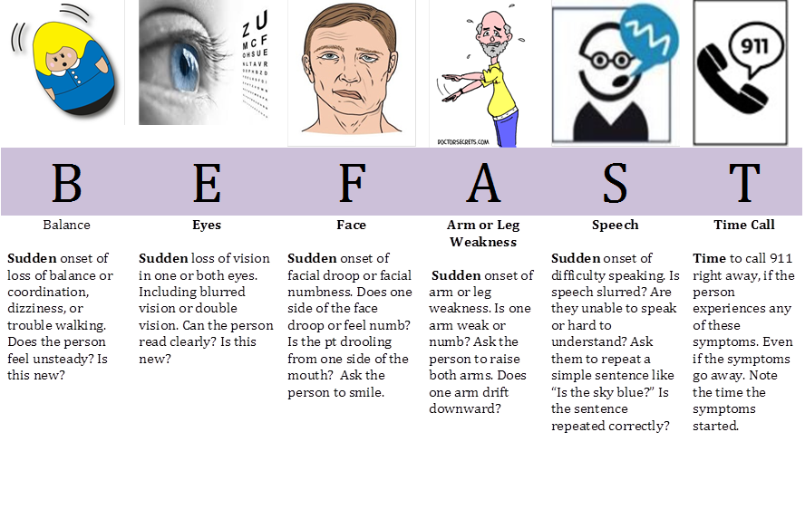

Slide 64

END
The CPR-Guy

Slide 65
REVIEW

Slide 66
Pharmacology is defined as the:
study of cells and tissues.
study of drugs and medications.
effects of medications in the lungs.
distribution of drugs to the body’s tissues.

Slide 67
Answer: B
Rationale: Pharmacology is the field of science that deals with the study of drugs and medications.

Slide 68
Pharmacology is defined as the:
study of cells and tissues. Rationale: This is physiology, which is a branch of biology.
study of drugs and medications. Rationale: Correct answer
effects of medications in the lungs. Rationale: This is pharmacodynamics, which includes the processes of the body’s response to medications.
distribution of drugs to the body’s tissues. Rationale: This is pharmacokinetics, which studies medication distribution within the body.

Slide 69
Which of the following statements regarding medications is FALSE?
Many medications are known by different names.
Some medications affect more than one body system.
Over-the-counter drugs must be prescribed by a physician.
EMTs should ask about any herbal remedies or vitamins that the patient may be taking.

Slide 70
Answer: C
Rationale: Over-the-counter (OTC) drugs, such as aspirin, Tylenol, and Motrin, do not require a physician prescription. They can be purchased at a supermarket or drugstore. Most medications have a generic name and a trade name. For example, acetaminophen is the generic name for Tylenol, and ibuprofen is the generic name for Motrin.

Slide 71
Which of the following statements regarding medications is FALSE?
Many medications are known by different names. Rationale: True; medications can have several different names.
Some medications affect more than one body system. Rationale: True; medications can affect many different body systems.
Over-the-counter drugs must be prescribed by a physician. Rationale: Correct answer
EMTs should ask about any herbal remedies or vitamins that the patient may be taking. Rationale: True; herbal remedies and vitamins can have interactions and effects on the patient’s health and condition.

Slide 72
Which of the following routes of medication administration has the fastest effect?
Oral
Intravenous
Subcutaneous
Intramuscular

Slide 73
Answer: B
Rationale: Because its administration is directly into a vein, a drug given intravenously enters the body quickly. The intravenous route is the fastest acting of all the routes of medication administration.

Slide 74
Which of the following routes of medication administration has the fastest effect?
Oral Rationale: The medication must be absorbed through the mucous membranes first to get to the circulatory system.
Intravenous Rationale: Correct answer
Subcutaneous Rationale: The medication must pass through the layers of skin before reaching the circulatory system.
Intramuscular Rationale: The medication needs to travel to the circulatory system.

Slide 75
When administered to a patient, a metered-dose inhaler will:
deliver the same dose each time it is administered.
be ineffective when given to patients with asthma.
deliver a different dose each time it is administered.
be delivered to the lungs over a period of 6 to 8 hours.

Slide 76
Answer: A
Rationale: The metered-dose inhaler (MDI) delivers the same dose of medication each time it is used. Drugs given via the MDI act very quickly and are commonly prescribed to patients with asthma, emphysema, and other airway diseases.

Slide 77
When administered to a patient, a metered-dose inhaler will:
deliver the same dose each time it is administered. Rationale: Correct answer
be ineffective when given to patients with asthma. Rationale: An inhaler is usually prescribed for patients with asthma.
deliver a different dose each time it is administered. Rationale: An inhaler is metered to deliver the same dose every time.
be delivered to the lungs over a period of 6 to 8 hours. Rationale: The medication is delivered straight to the lungs, almost immediately, because it is inhaled.

Slide 78
You are managing a 62-year-old woman who complains of crushing chest pain. Her blood pressure is 84/64 mm Hg, and her heart rate is 110 beats/min. Medical control advises you to assist her in taking her prescribed nitroglycerin. After receiving this order, you should:
reassess the patient’s heart rate and then assist with the nitroglycerin.
repeat the patient’s blood pressure to the physician and confirm the order.
wait 10 minutes, reassess the blood pressure, and then give the nitroglycerin.
administer the nitroglycerin to the patient and then reassess her blood pressure.

Slide 79
Answer: B
Rationale: Nitroglycerin is a vasodilator and lowers blood pressure (BP); therefore, it should not be given to patients with a systolic BP less than 100 mm Hg. If you receive an order to give nitroglycerin to a patient with a systolic BP less than 100 mm Hg, you should ensure that the physician is aware of the patient’s BP, then reconfirm the order.

Slide 80
You are managing a 62-year-old woman who complains of crushing chest pain. Her blood pressure is 84/64 mm Hg, and her heart rate is 110 beats/min. Medical control advises you to assist her in taking her prescribed nitroglycerin. After receiving this order, you should:
reassess the patient’s heart rate and then assist with the nitroglycerin. Rationale: Administration of nitroglycerin is based on the patient’s blood pressure, not on the patient’s heart rate.
repeat the patient’s blood pressure to the physician and confirm the order. Rationale: Correct answer

Slide 81
You are managing a 62-year-old woman who complains of crushing chest pain. Her blood pressure is 84/64 mm Hg, and her heart rate is 110 beats/min. Medical control advises you to assist her in taking her prescribed nitroglycerin. After receiving this order, you should:
wait 10 minutes, reassess the blood pressure, and then give the nitroglycerin. Rationale: You should ensure that the physician is aware of the patient’s blood pressure and then reconfirm the order.
administer the nitroglycerin to the patient and then reassess her blood pressure. Rationale: Nitroglycerin is a vasodilator and lowers the patient’s blood pressure. This medication should not be given to patients with a systolic blood pressure less than 100 mm Hg.

Slide 82
Activated charcoal is indicated for patients who have ingested certain drugs and toxins because it:
acts as a direct reversal agent for most medications.
induces vomiting before the chemical can be digested.
detoxifies the drug before it can cause harm to the patient.
binds to chemicals in the stomach and delays absorption.

Slide 83
Answer: D
Rationale: Activated charcoal is an adsorbent—that is, it binds to harmful chemicals that have been ingested. This binding effect delays digestion and absorption of the chemical by the body.

Slide 84
Activated charcoal is indicated for patients who have ingested certain drugs and toxins because it:
acts as a direct reversal agent for most medications. Rationale: Activated charcoal binds with chemicals.
induces vomiting before the chemical can be digested. Rationale: Activated charcoal is not the medication used to induce vomiting.
detoxifies the drug before it can cause harm to the patient. Rationale: Activated charcoal binds with chemicals, delays absorption, and helps in getting chemicals through the digestive system.
binds to chemicals in the stomach and delays absorption. Rationale: Correct answer

Slide 85
With regard to pharmacology, the term “action” refers to the:
ability of a drug to cause harm.
ability of a drug to produce side effects.
amount of time it will take the drug to work.
expected effect of a drug on the patient’s body.

Slide 86
Answer: D
Rationale: As it applies to pharmacology, the term “action” refers to the effect that a drug is expected to have on a patient’s body. Prior to administering any drug, the EMT must be aware of its action(s) on the body.

Slide 87
With regard to pharmacology, the term “action” refers to the:
ability of a drug to cause harm. Rationale: This is called a contraindication.
ability of a drug to produce side effects. Rationale: This is any action of a medication other than the desired ones.
amount of time it will take the drug to work. Rationale: This is the onset of action.
expected effect of a drug on the patient’s body. Rationale: Correct answer

Slide 88
Which of the following patients is the BEST candidate for oral glucose?
Conscious patient who is showing signs of hypoglycemia
Unconscious diabetic patient with a documented low blood sugar
Conscious diabetic patient suspected of being hyperglycemic
Semiconscious patient with signs and symptoms of low blood sugar

Slide 89
Answer: A
Rationale: Oral glucose is given to diabetic patients with suspected or documented hypoglycemia (low blood sugar). It should not be given to unconscious patients or those who are otherwise unable to swallow because it may be aspirated into the lungs.

Slide 90
Which of the following patients is the BEST candidate for oral glucose?
Conscious patient who is showing signs of hypoglycemia Rationale: Correct answer
Unconscious diabetic patient with a documented low blood sugar Rationale: Oral glucose should not be given to unconscious patients.
Conscious diabetic patient suspected of being hyperglycemic Rationale: Oral glucose is used for the treatment of hypoglycemia (low blood sugar).
Semiconscious patient with signs and symptoms of low blood sugar Rationale: Oral glucose should not be given to those patients who are unable or may become unable to swallow.

Slide 91
Epinephrine is given to patients with anaphylactic shock because of its effects of:
bronchodilation and vasodilation.
bronchodilation and vasoconstriction.
vasodilation and bronchoconstriction.
bronchoconstriction and vasoconstriction.

Slide 92
Answer: B
Rationale: The two major complications associated with anaphylactic shock are bronchoconstriction, which impairs air movement in and out of the lungs, and vasodilation, which causes a drop in blood pressure. Epinephrine reverses these processes by causing bronchodilation and vasoconstriction, thereby improving breathing and increasing the blood pressure, respectively.

Slide 93
Epinephrine is given to patients with anaphylactic shock because of its effects of:
bronchodilation and vasodilation. Rationale: Epinephrine dilates the bronchi but constricts the circulatory system.
bronchodilation and vasoconstriction. Rationale: Correct answer
vasodilation and bronchoconstriction. Rationale: Epinephrine constricts the circulatory system and dilates the bronchi.
bronchoconstriction and vasoconstriction. Rationale: Epinephrine dilates the bronchi and constricts the circulatory system.

Slide 94
The process by which medications travel through body tissues until they reach the bloodstream is called:
adsorption.
onset of action.
absorption.
transformation.

Slide 95
Answer: C
Rationale: The process by which medications travel through body tissues until they reach the bloodstream is called absorption. Adsorption refers to the binding of one chemical to another. Activated charcoal, for example, delays absorption of certain chemicals into the bloodstream because it adsorbs (binds to) them in the stomach.

Slide 96
The process by which medications travel through body tissues until they reach the bloodstream is called:
adsorption. Rationale: In adsorption, particles bind to a surface.
onset of action. Rationale: Onset of action is the time that it takes for a medication to start doing what it is prescribed for.
absorption. Rationale: Correct answer
transformation. Rationale: This has nothing to do with medication administration.

